Slide 1

Note: The data and information in this document is reflective of a hypothetical situation and client. This document is to be used for KPMG Virtual Internship purposes only.
Sprocket Central Pty Ltd
Data Analytics Approach
Sachin Rana

Slide 2
Note: The data and information in this document is reflective of a hypothetical situation and client. This document is to be used for KPMG Virtual Internship purposes only.
Agenda
Introduction
Data Exploration
Model Development
Interpretation

Slide 3
Note: The data and information in this document is reflective of a hypothetical situation and client. This document is to be used for KPMG Virtual Internship purposes only.
Introduction
Identify and Recommend Top 1000 Customer to Target from Datasets
Outline of Problem
Contents of Data Analysis
Sprocket Central is a company that specializes in high-quality bikes and cycling accessories.
Their marketing team is looking to boost business sales by analyzing provided datasets.
Using the 3 datasets provided the aim is to analyze and recommend 1000 customers that Sprocket Central should target to drive higher value for the company.
'New' and 'Old' Customer Age Distributions.
Bike related purchases over the last 3 years by gender.
Job industry distributions.
Wealth segmentation by age category
Number of cars owned and not owned by state.
RFM analysis and customer classification.
This will be done with the three phases of: Data Exploration,Model Development, and Interpretation.

Slide 4
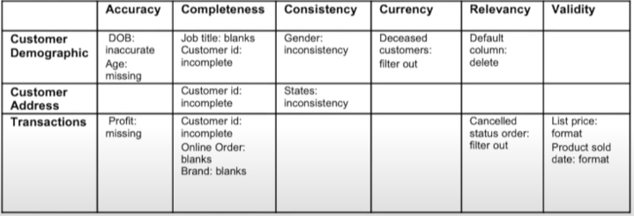
Note: The data and information in this document is reflective of a hypothetical situation and client. This document is to be used for KPMG Virtual Internship purposes only.
Data Exploration
Data Quality Assessment and 'Clean Up'
Key Issues for Data Quality Assessment
Summary Table
Accuracy: Correct Values
Completeness: Data Fields with Values
Consistency: Values Free from Contradiction
Currency: Values up to Date
Relevancy: Data items with Value Meta-data
Validity: Data Containing Allowable Values
Uniqueness: Records that are Duplicated

Slide 5
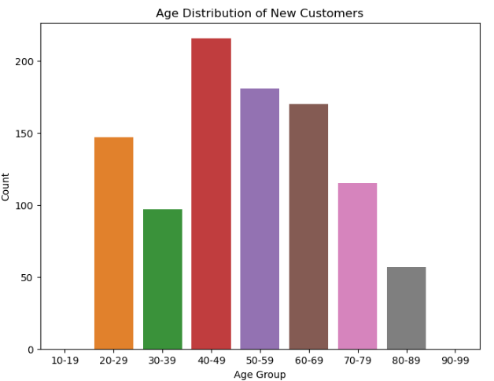
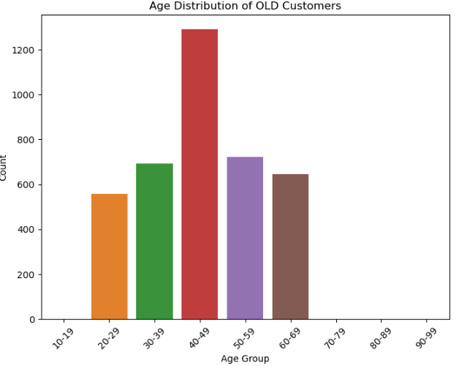
Note: The data and information in this document is reflective of a hypothetical situation and client. This document is to be used for KPMG Virtual Internship purposes only.
most
Data Exploration
Data Quality Assessment and 'Clean Up'
'New' and 'Old' Customer Age Distributions
Most customers are aged between 40-49 in 'New.' and
'Old' customers.
The lowest age groups are under 20 and 80+ for both
'New' and 'Old' customer lists
The 'New' customer list suggests that age groups 20
29 and 40-69 are most populated.
The 'Old' customer list suggests 20-69.
There is a steep drop of customers in the 30-39 age
group in 'New.'

Slide 6
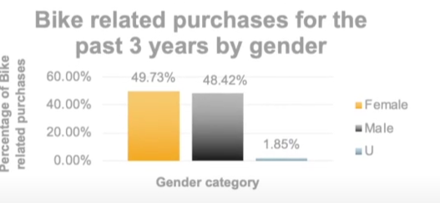
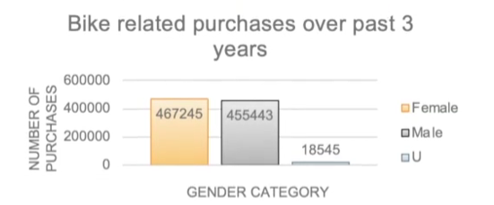
Note: The data and information in this document is reflective of a hypothetical situation and client. This document is to be used for KPMG Virtual Internship purposes only.
most
Data Exploration
Bike related purchases over last 3 years by gender
Over the last three years about 50% of bike related
purchases were made by females to 48% of purchases
by males. Approximately 2% were made by unknown gender.
Numerically, females purchases almost 10 000 more than
males.
Females make up majority of bike related sales.

Slide 7
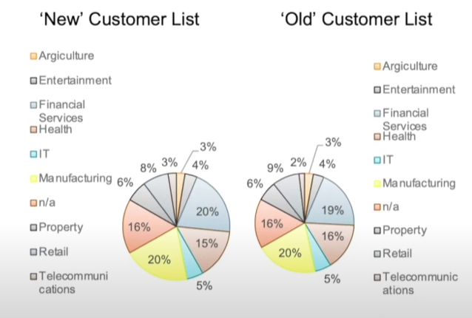
Note: The data and information in this document is reflective of a hypothetical situation and client. This document is to be used for KPMG Virtual Internship purposes only.
most
Data Exploration
Job Industry Distribution
20% of 'New' Customers are in Manufacturing and
Financial Services.
The smallest number of customers are in Agriculture and
Telecommunications at 3%.
Similar pattern in 'Old' customer list, at 20% and 19% in
Manufacturing and Financial Services respectively.

Slide 8
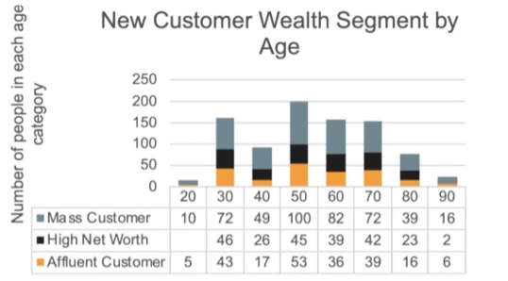
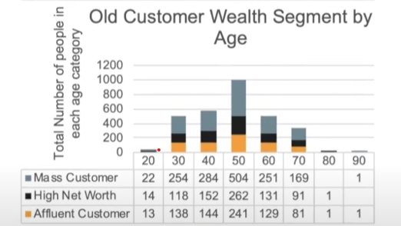
Note: The data and information in this document is reflective of a hypothetical situation and client. This document is to be used for KPMG Virtual Internship purposes only.
most
Data Exploration
Wealth Segmentation by age category
In all age categories the largest number of customers are
classified as 'Mass Customer'
The next category is the 'High Net Worth' customers.
The 'Affluent Customer' can outperforms the 'High Net
Worth' customer in the 40-49 age group.

Slide 9
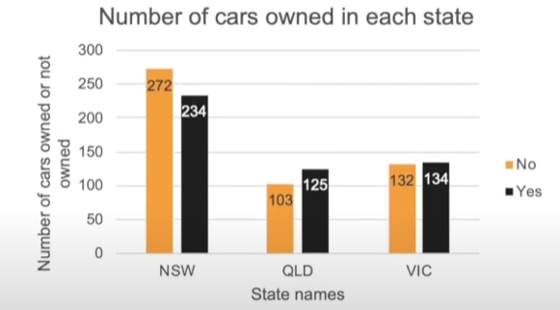
Note: The data and information in this document is reflective of a hypothetical situation and client. This document is to be used for KPMG Virtual Internship purposes only.
most
Data Exploration
Number of cars owned and not owned by state
NSW has the largest amount of people that do not own a
car. NSW seems to have a higher number of people from
which data was collected.
Victoria is also split quite evenly. But both numbers are
significantly lower than those of NSW.
QLD has a relatively high number of customers that own a
car.

Slide 10
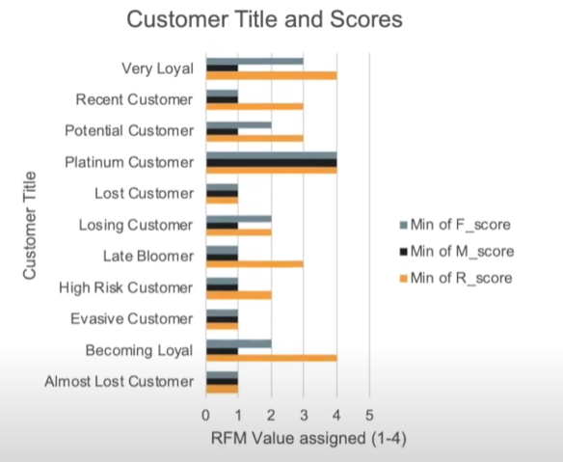
Note: The data and information in this document is reflective of a hypothetical situation and client. This document is to be used for KPMG Virtual Internship purposes only.
Model Development
RFM Analysis and Customer Classification
● RFM analysis is used to determine which
customers a business should target to increase
its revenue and value.
● The RFM (Recency, Frequency, and Monetary)
model shows customers that have displayed
high levels of engagement with the business in
the three categories mentioned.

Slide 11
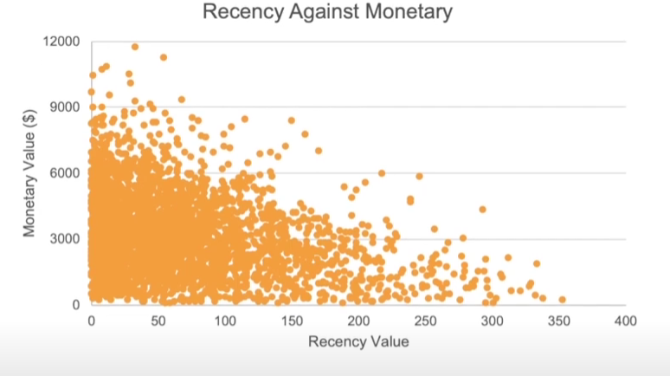
Note: The data and information in this document is reflective of a hypothetical situation and client. This document is to be used for KPMG Virtual Internship purposes only.
Model Development
Scatter-Plot based off RFM Analysis
The chart shows that customers who purchased more recently have generated more revenue, than customer who visited a while ago.
Customers from recent past (50-100 days) also show to generate a moderate amount of revenue.
Those who visited more than 200 days ago generate low revenue.

Slide 12
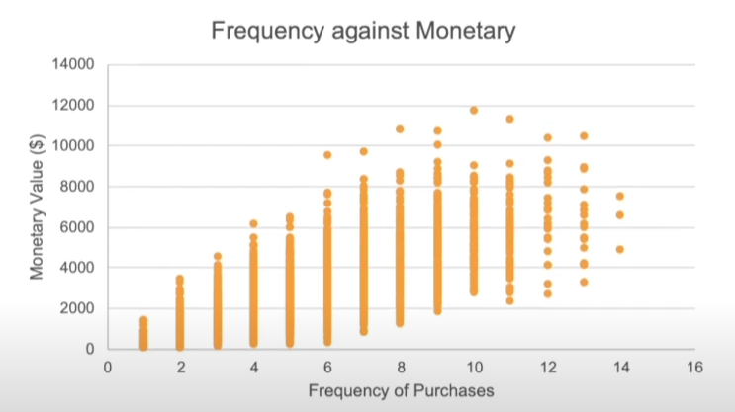
Note: The data and information in this document is reflective of a hypothetical situation and client. This document is to be used for KPMG Virtual Internship purposes only.
Model Development
Scatter-Plot based off RFM Analysis
Customer classified as "Platinum Customer," "Very Loyal," and "Becoming Loyal" visit frequently, which correlated with increased revenue for the business.
Naturally, there is a positive relationship between frequency and monetary gain for the business.

Slide 13
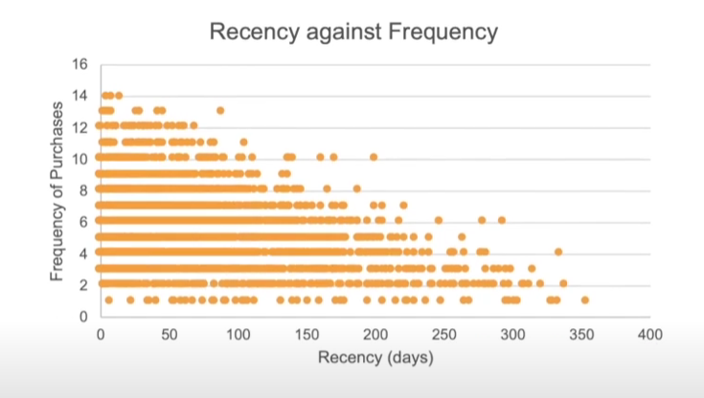
Note: The data and information in this document is reflective of a hypothetical situation and client. This document is to be used for KPMG Virtual Internship purposes only.
Model Development
Scatter-Plot based off RFM Analysis
Very low frequency of 0-2 correlated with high recency values. i.e. More than 250 days ago.
Customers that have visited more recently (0-50 days) have a higher chance of visiting more frequently (6+).
Higher frequency has a negative relationship with recency values. Such that very recent customers are also frequent customers.

Slide 14
Note: The data and information in this document is reflective of a hypothetical situation and client. This document is to be used for KPMG Virtual Internship purposes only.
Model Development
Customer Title Definition list with RFM values assigned
Rank | Customer Title | Description | RFM Value
1 | Platinum Customer | Most recent buy, buys often, most spent | 444
2 | Very Loyal | Most recent, buys often, spends large amount of money | 433
3 | Becoming Loyal | Relatively recent, bought more than once, spends large amount of money | 421
4 | Recent Customer | Bought recently, not very often, average money spent | 344
5 | Potential Customer | Bought recently, never bought before, spent small amount | 323
6 | Late bloomer | No purchases recently, but RFM value is larger than average | 311
7 | Losing Customer | Purchases was a while ago, below average RFM value | 224
8 | High Risk Customer | Purchase was long time ago, frequency is quite high, amount spent is high | 212
9 | Almost Lost Customer | Very low recency, low frequency, but high amount spent | 124
10 | Very low recency | Very low frequency, small amount spent | 112
11 | Lost Customers | Very Low RFM | 111

Slide 15
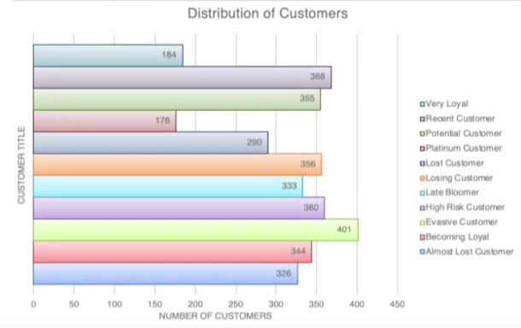
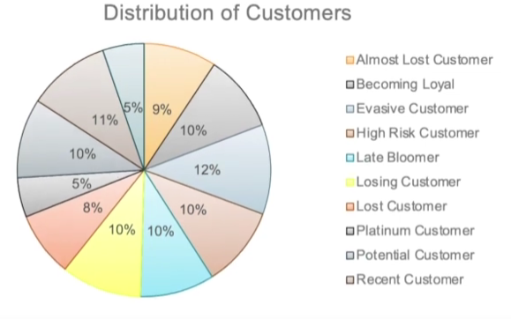
Note: The data and information in this document is reflective of a hypothetical situation and client. This document is to be used for KPMG Virtual Internship purposes only.
Model Development
Customer Title Distribution in Dataset

Slide 16
Summary Table of Top 1000 Customers to Target
Rank | Customer Title | Description | Number of Customers | Cumulative | Customer Selection
1 | Platinum Customer | Most recent buy, buys often, most spent | 176 | 176 | 176
2 | Very Loyal | Most recent, buys often, spends large amount of money | 184 | 360 | 184
3 | Becoming Loyal | Relatively recent, bought more than once, spends large amount of money | 344 | 704 | 344
4 | Recent Customer | Bought recently, not very often, average money spent | 368 | 1072 | 296
5 | Potential Customer | Bought recently, never bought before, spent small amount | 355 | 1427 | 0
6 | Late bloomer | No purchases recently, but RFM value is larger than average | 333 | 1760 | 0
7 | Losing Customer | Purchases was a while ago, below average RFM value | 356 | 2116 | 0
8 | High Risk Customer | Purchase was long time ago, frequency is quite high, amount spent is high | 360 | 2476 | 0
9 | Almost Lost Customer | Very low recency, low frequency, but high amount spent | 326 | 2802 | 0
10 | Evasive Customers | Very low frequency, small amount spent | 401 | 3203 | 0
11 | Lost Customers | Very Low RFM | 290 | 3493 | 0

Slide 17
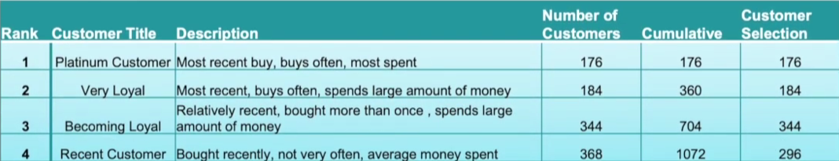
Note: The data and information in this document is reflective of a hypothetical situation and client. This document is to be used for KPMG Virtual Internship purposes only.
Interpretation
Customer Target and Methodology
Filter through the top 1000 customers assigning the condition discussed in the table above.
The 1000 customers discovered would have bought recently,they have bought very frequently in the past and tend to spend more than other customers.

Slide 18
Note: The data and information in this document is reflective of a hypothetical situation and client. This document is to be used for KPMG Virtual Internship purposes only.
Thank You

